Slide 1
Update

Slide 3
Evaluation
Navigation
Air Washington
Navigation Policies and Procedures
Data collection
NCRC
Update later by Sue Bradshaw
Comparison Cohort
South (non-WISE) vs. Bates (WISE) in the category of Manufacturing Academy

Slide 5
Data Analyst
The path
Originally going to done out of house by 3rd party
Undoable due to ESD rules
Budget Modification needed to bring in house under Centralia IR
IR position eliminated after President Frost’s exit
Position will now report to Lead Program Manager
Change in reporting and duties required data position to be re-posted
We are planning on interviewing candidates at the end of the month

Slide 7
Policies & Procedures
Considered an important documents by the DOL
This will be a living document
First Draft is done – thanks goes to James Hovis for his steady work on this
After revisions comments will be solicited from the consortium colleges
Areas of concern
Many colleges do not have their own codified Policies and Procedures
Hopefully there will be few if any conflicts but if there are negotiating them may be tricky

Slide 9
Site Visit
WISE consortium’s first site visit will occur 4/11-4/14/16
FPO Elise Wang will spend half of her time on programmatic work and half on fiscal
She is also considering a stop off at one of the sub-recipient college on her way out – likely Renton
We do not have an agenda or anymore details from her office at this time.

Slide 10
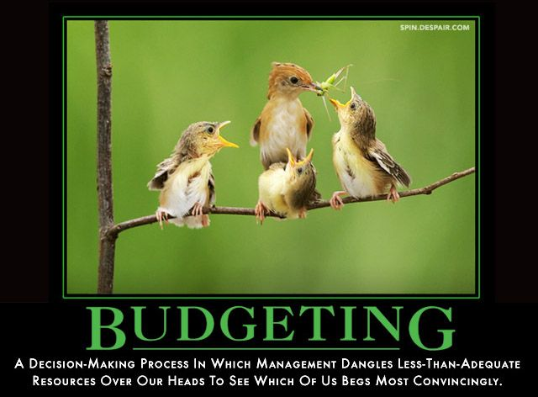

Slide 11
Budget Update
 | Pacific Northwest Center of Excellence for Clean Energy
 | Fiscal Report Ending 12/31/15 |  |  |  |  |  |  | DATE | 2/1/2016
BUDGET STATUS
Sub-recipients | Yr. 1 Budget | Yr. 1 Expenditures | Yr. 1 Remaining Budget | Yr. 2 Budget | Yr. 2 Expenditures | Yr. 3 Budget | Yr. 4 Budget | Total Grant Funds | Total Remaining Budget
Centralia | $ 399,941 | 171,728 | 228,213 | 590,691 | 163,657 | 576,240 | 281,510 | 1,848,382 | 1,512,998
Everett | $ 443,619 | 203,482 | 240,137 | 469,305 | 92,302 | 460,306 | 42,546 | 1,415,776 | 1,119,992
Renton | $ 359,202 | 220,898 | 138,304 | 433,972 | 128,822 | 432,649 | 41,342 | 1,267,165 | 917,446
Green River | $ 295,012 | 82,677 | 212,335 | 416,993 | 39,585 | 406,856 | 74,556 | 1,193,417 | 1,071,155
Shoreline | $ 443,904 | 102,379 | 341,525 | 357,164 | 108,789 | 374,376 | 47,697 | 1,223,141 | 1,011,974
Bates | $ 441,283 | 243,246 | 198,037 | 327,125 | 90,818 | 328,934 | 41,300 | 1,138,642 | 804,578
S. Seattle | $ 195,698 | 99,423 | 96,275 | 255,389 | 39,663 | 222,041 | 14,536 | 687,664 | 548,578
Walla Walla | $ 603,824 | 137,421 | 466,403 | 308,220 | 168,454 | 308,623 | 0 | 1,220,667 | 914,792
Total | $ 3,182,483 | 1,261,253 | 1,921,230 | 3,158,859 | 832,089 | 3,110,025 | 543,487 | 9,994,854 | 7,901,512
Total Grant Funds for 4 years | $ 9,994,854.00
Total Expenditures to Date | $ 2,093,342.44
Percent of Expenditures | 20.94%
Percent of Project Time Completion | 31.25%

