Slide 1
Module 3
Current Status of the Nation’s
Electric Infrastructure &
Opportunities for Modernization
This module will discuss the existing electric grid and power system and summarize how electric utilities operate today.
It will then introduce how this might change with Smart Grid.

Slide 2
Introduction and Overview
Part 1: Background
Part 2: Generation
Part 3: Transmission
Part 4: Distribution
Part 5: Operations

Slide 3
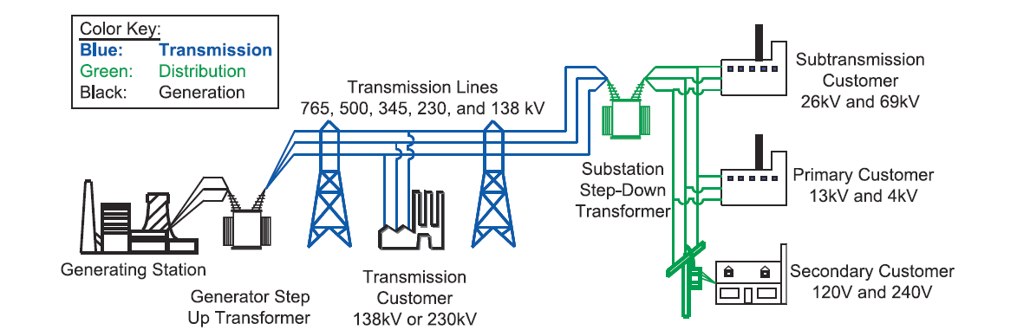
Part 1: Background
Notes:
Source: http://www.ferc.gov/industries/electric/indus-act/reliability/blackout/ch1-3.pdf
Key points:
Power is generated from a variety of sources, which we’ll get to shortly. Each different source has its own characteristics:
--Mixture of costs, both initial costs and operating costs (some plants are very expensive to build but less expensive to operate, some are more of a mix, some have free fuel, but have capital costs to build.
--Security of fuel supply (how many years of supply do we have, in the case of fossil fuels, and does it come from within the US or within North America? Is the fuel free, as in the case of renewables?)
--Ease of dispatch (can we decide how much power to generate at any given time, as in fossil fuel and nuclear plants, or are we constrained by things like seasonal variations in rainfall (for hydro) or whether or not the wind is blowing or the sun is shining (for wind and solar))
--Environmental impacts (does it generate pollution? Are the plants resource-intensive to build? Is wildlife affected? Are global warming gases generated?)
Power is generated at moderate voltages (10s of kV) in most plants, and then we step it up to very high voltage, using transformers, in order to send it to customers. We step up the voltage because in order to send a given amount of power, if the voltage is higher the current will be lower, and the lower the current, the lower the losses due to resistive heating.

Slide 4
U.S. Electric Infrastructure
Generation
  18,000 generators at 5,800 power plants
    589 coal plants generate 42% of electricity
    1,646 natural gas plants generate 25% of electricity
    104 nuclear reactors at 66 plants generate 20% of electricity
    renewables generate 13% of electricity
  530GW (51% of capacity) are >30 years old, most gas and wind is <10 years old, most coal and hydro is >30 years old, almost all nuclear is >20 years old
Transmission
  over 150,000 miles of high voltage transmission lines in the U.S.
  ~7,000 transmission substations
Distribution
  over 2,500,000 miles of distribution lines in the U.S.
  over 100,000 distribution substations
About 7% of all generated electricity is lost in transmission and distribution.
Notes:
Data from eia, including
http://www.eia.gov/tools/faqs/faq.cfm?id=105&t=3
http://www.eia.gov/tools/faqs/faq.cfm?id=110&t=3

Slide 5
Key Characteristics of Electricity
Electricity is a service that is sold as a commodity.
Electricity is not stored and delivery is nearly instantaneous.
  Generation and load must be always in balance.
Supply of electricity requires networks, where electricity is injected or retrieved but cannot be traced.
Electricity is an essential public service.
  Guarantee of supply and price are politically sensitive issues.
Large and dedicated investments are required to produce and distribute electricity.
Complex decision making under uncertainty.
Predictable cyclical variations in demand.

Slide 6
Electricity Fundamentals
Frequency
  Almost entire U.S. grid operates on AC, at 60Hz, or 60 cycles per second
  a small portion of the transmission grid is DC
Transmission: very high voltage
  765kV, 500kV, 345kV, 230kV, 169kV, 138kV, 69kV
  3-phase balanced
    Three parallel lines (A, B, and C phase) each carry 1/3 of the power, each out of synch by 120°
Distribution: moderate voltage
  1kV – 40kV, most common is 12.47kV
  3-phase unbalanced
    A, B, C phases not all present or not the same magnitude at all points
End Use: mostly low voltage
  Residential customers: 120V single phase, 240V dual phase
  Commercial and Industrial customers: 120V to 69kV
Three phase power
Notes:
Briefly define DC / AC here – we will come back to it in the transmission section.
At the transmission level, there are overlapping networks at a variety of voltages – we’ll see a map later. Higher voltage lines can carry more power. The variety of voltage levels seen in overlapping networks is a product of a complex history with multiple regulatory bodies and many commercial and governmental actors.
Explain three phase power here, contrast balanced three phase power seen in transmission system with unbalanced three phase power seen in distribution networks. The power that we’re mostly used to seeing in residences is single phase, 120V from live to GND, although some large home appliances use 240V.

Slide 7
Scale of Electricity Use in U.S.
Energy = Power ∙ time
Wh = Watt ∙ hour
1 MW = 1,000 kW
1 kW = 1,000 W
Energy
U.S. Production in 2011 | 4,105,734,000 MWh
Average residential monthly use | 958 kWh
heat water for a 15 minute shower | 10 kWh
a single cycle on an electric dryer | 2.5 kWh
watch a 1 hour program on a big-screen plasma TV | 200 Wh
charge a smartphone | 10 Wh
Power
Peak U.S. capacity | 1,039,062 MW
Largest plant by capacity: Grand Coulee Dam | 7,079 MW
Average nuclear plant | 1,000 MW
Average coal plant | 300 MW
Utility-scale wind turbine | 0.5-5 MW
Solar PV (residential) | 1-5 kW / rooftop
Notes:
http://www.eia.gov/energyexplained/index.cfm?page=electricity_home#tab2
This slide is a good opportunity to remind people of the relationship between power and energy and to talk about units briefly. A Watt-hour is a unit of energy, and it means that electricity is produced or consumed at a rate of 1 Watt for a time period of 1 hour. For the power table, make sure to note the differences between MW and kW. For the energy table, note the difference between MWh, kWh, Wh.
There’s a lot of variation in the size of plants, these are just rough averages meant to give a sense of scale. Nuclear plants are very large, coal plants are also quite large. An average utility-scale wind turbine will be 1-5MW, but wind farms will typically have a few dozens-hundreds of turbines, so the output of a wind farm can be as large as a few hundred MW. A rooftop solar PV project is much smaller by contrast, only 1-5kW. There are a small number of utility scale PV plants, which tend to be in the high tens of MW.
People might be surprised by some of the energy consumption numbers. It’s a good opportunity to point out that activities like space heating and cooling and water heating require very significant amounts of electricity compared to electronics.

Slide 8
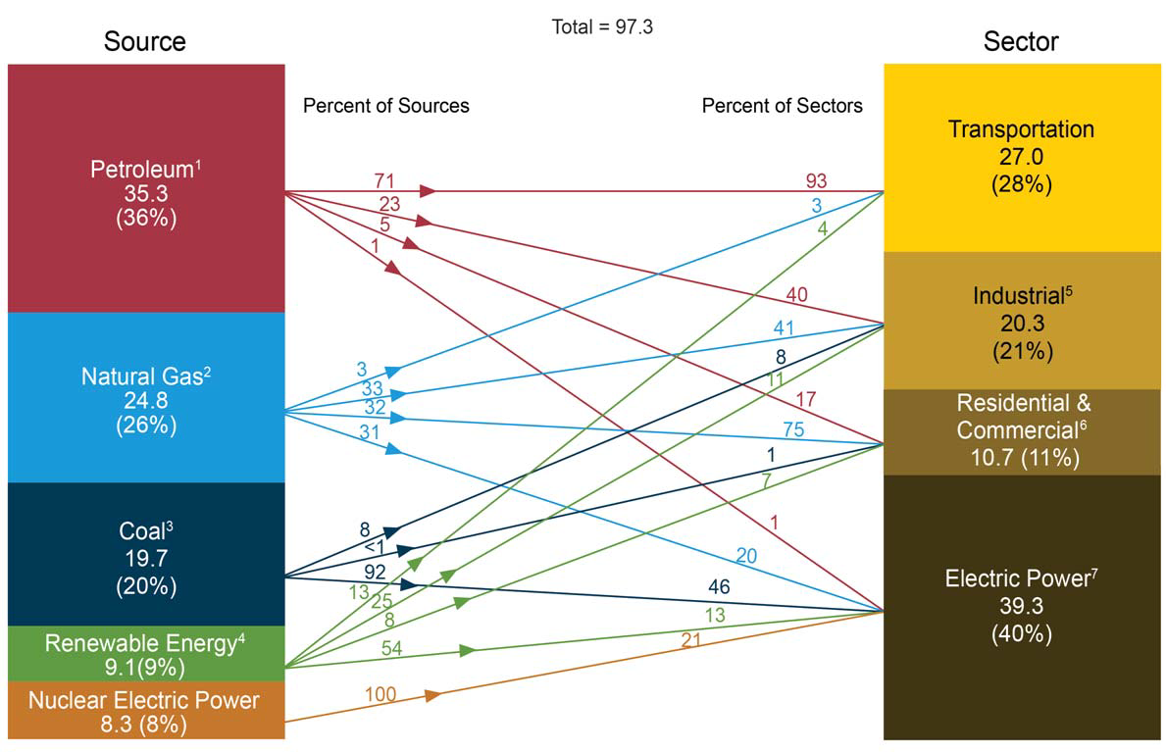
Total U.S. Energy Consumption
EIA Annual Energy Review
Notes:
AEO 2011 slide 37 (http://www.eia.gov/totalenergy/data/annual/pdf/aer.pdf)
Highlight the bottom right Electric Power block. 40% of the total energy that the U.S. uses is in the form of electric power.
Point out the mixture of different primary sources of energy that go into electric power. Note the high percentage of coal (that has been decreasing as the recently much lower price of natural gas has been displacing some coal generation), percentage of nuclear and renewable in the mixture, and that almost no petroleum goes into generating electricity – almost all of it is used for transportation and industrial activities.
Footnotes, from http://www.eia.gov/totalenergy/data/annual/pdf/aer.pdf:
1 Does not include biofuels that have been blended with petroleum—biofuels are included in “Renewable Energy."
2 Excludes supplemental gaseous fuels.
3 Includes less than 0.1 quadrillion Btu of coal coke net imports.
4 Conventional hydroelectric power, geothermal, solar/photovoltaic, wind, and biomass.
5 Includes industrial combined-heat-and-power (CHP) and industrial electricity-only plants.
6 Includes commercial combined-heat-and-power (CHP) and commercial electricity-only plants.
7 Electricity-only and combined-heat-and-power (CHP) plants whose primary business is to sell electricity, or electricity and heat, to the public. Includes 0.1 quadrillion Btu of electricity net imports not shown under “Source.”
Notes: Primary energy in the form that it is first accounted for in a statistical energy balance, before any transformation to secondary or tertiary forms of energy (for example, coal is used to generate electricity). • Sum of components may not equal total due to independent rounding.

Slide 9
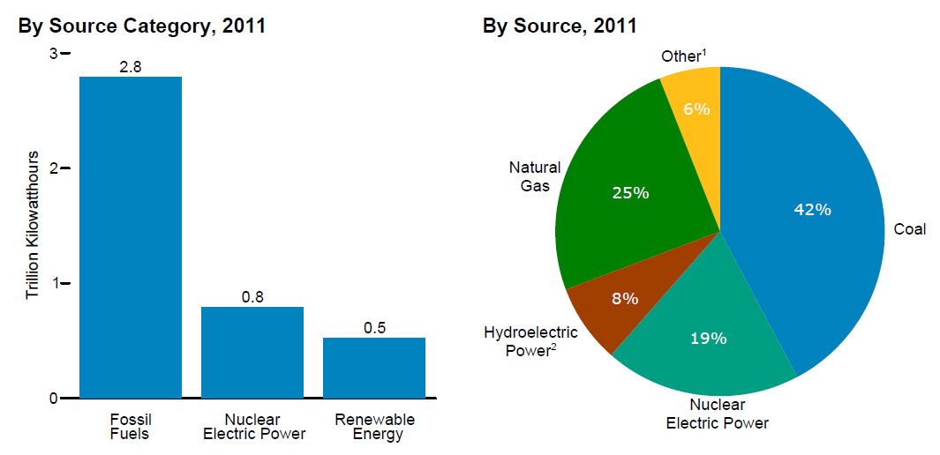
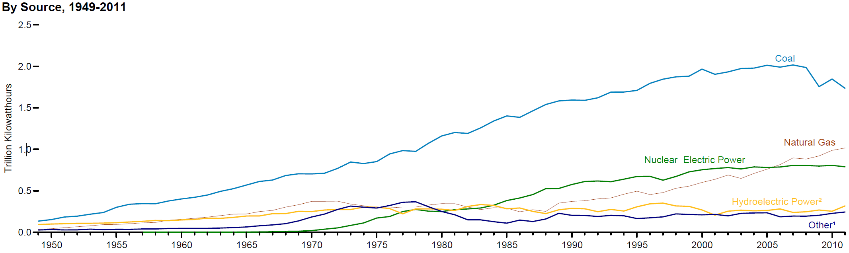
Part 2: Generation
EIA Annual Energy Review
Notes:
AEO 2011 slide 222 (http://www.eia.gov/totalenergy/data/annual/pdf/aer.pdf)
This is the amount of electricity and percentage of total electricity generated by each source.
Note that fossil fuels are our dominant source of electricity. The contributions of nuclear and hydro have held steady for many years at 20% and 8%, respectively. The share of electricity produced by renewables has been growing rapidly in recent years, but they remain a very small source. All non-hydro renewables are contained in the “Other” category. In recent years, with the introduction of new technology (hydraulic fracturing) the price of natural gas has fallen sharply, leading to a displacement of coal generation with natural gas.
Footnotes, from http://www.eia.gov/totalenergy/data/annual/pdf/aer.pdf:
1 Wind, petroleum, wood, waste, geothermal, other gases, solar thermal and photovoltaic, batteries, chemicals, hydrogen, pitch, purchased steam, sulfur, miscellaneous technologies, and non-renewable waste (municipal solid waste from non-biogenic sources, and tire-derived fuels).
2 Conventional hydroelectric power and pumped storage.
Note: Sum of components may not equal 100 percent due to independent rounding.

Slide 10
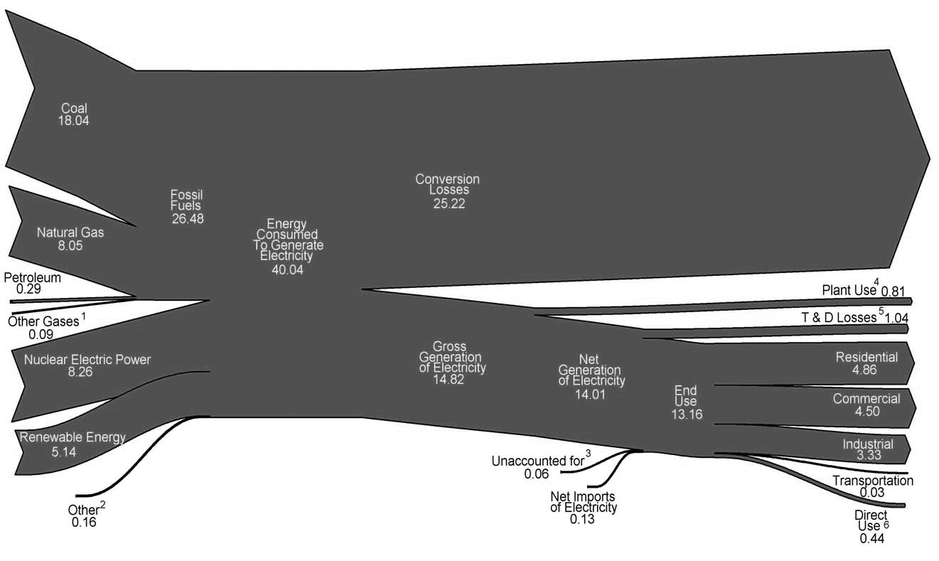
The Path from Fuel to Electricity
Units: quadrillion BTU = 10¹⁵ BTU
Annual global primary energy consumption: 450 quads
Annual US primary energy consumption: 100 quads
EIA Annual Energy Review
Notes:
AEO 2011 slide 219 (http://www.eia.gov/totalenergy/data/annual/pdf/aer.pdf)
The units on this figures are quads, or quadrillion BTU, or 10^15 BTU. A quad is 2.9 x 10^11 kWh. The global primary energy production in 2004 was 446 quads. The US primary energy consumption in 2011 was 97.3 quads. The unit is useful for speaking about U.S. and global energy budgets.
There will be questions about “Conversion Losses.” These refer to all energy that was present in the initial primary energy of the fuels used that was not transformed into electricity. There are many sources of these losses. The most important is the fundamental limit to the efficiency of thermal plants, deriving from the second law of thermodynamics. The efficiency is limited by difference between the hot stage and the cold stage of the steam cycle, and for physically realistic temperature values will never be very much higher than ~35% for a simple steam cycle. A variety of methods can be used to increase total plant efficiency, but that fundamental limit is still the largest source of losses. Other losses are mechanical inefficiencies, friction, lost heat, etc.
Footnotes, from http://www.eia.gov/totalenergy/data/annual/pdf/aer.pdf:
1 Blast furnace gas, propane gas, and other manufactured and waste gases derived from fossil fuels.
2 Batteries, chemicals, hydrogen, pitch, purchased steam, sulfur, miscellaneous technologies, and non-renewable waste (municipal solid waste from non-biogenic sources, and tire-derived fuels).
3 Data collection frame differences and nonsampling error. Derived for the diagram by subtracting the “T & D Losses” estimate from “T & D Losses and Unaccounted for” derived from
Table 8.1.
4 Electric energy used in the operation of power plants.
5 Transmission and distribution losses (electricity losses that occur between the point of generation and delivery to the customer) are estimated as 7 percent of gross generation.
6 Use of electricity that is 1) self-generated, 2) produced by either the same entity that consumes the power or an affiliate, and 3) used in direct support of a service or industrial process located within the same facility or group of facilities that house the generating equipment. Direct use is exclusive of station use.

Slide 11
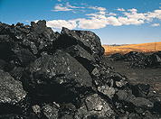
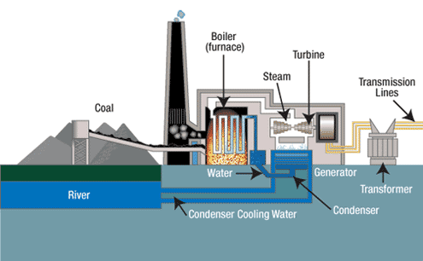
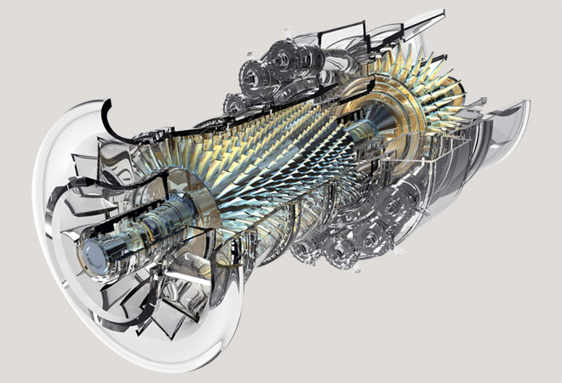
Fossil Fuels: Coal and Natural Gas
Coal Power Plant
Natural Gas Combustion Turbine
Tennessee Valley Authority
General Electric
Notes:
Coal plant schematic: TVA (http://www.tva.com/power/coalart.htm)
Picture of coal: http://www.netl.doe.gov/keyissues/historyofcoaluse.html
GE natural gas turbine: http://www.ge-energy.com/content/multimedia/_files/photos/9E%20Heavy%20Duty%20Gas%20Turbine_9E%20gas%20turbine%20angled_660x450.jpg
Coal is a combustible sedimentary rock, formed when dead plant matter fell into anoxic conditions (usually swampy water). Over millions of years, as the plant matter was compressed and heated, it underwent chemical and physical changes, becoming less oxygen-rich and gradually turning into coal. Coal is sometimes found deep underground and sometimes near the surface, depending on the geologic history of the location. Coal is mined in the US and around the world. The US has very large domestic reserves (over a 200 year supply at current rate of use).
Natural gas is a colorless, odorless gas, another word for methane, CH4. The feedstock for natural gas (and oil) is tiny marine organisms, which died and were buried on the ocean floor. Over millions of years, as the organic matter was compressed and heated, it underwent chemical and physical changes. Natural gas is a smaller, lighter hydrocarbon molecule (it spent longer time periods at higher temperatures and pressures), whereas oil is comprised of a mixture of larger and more complex hydrocarbon molecules. To obtain natural gas we drill into geologic formation which have trapped hydrocarbons. The practice of “fracking,” or forcing a high pressure mixture of sand and water into formations to increase the permeability and allow the flow of oil and gas, is a recent technological innovation that has vastly increased the domestic natural gas supply but had very controversial environmental consequences.
Coal has historically produced some of the least expensive electricity available, and has produced more electricity than any other source. In recent years, the price of coal has remained constant while the price of natural gas has fallen dramatically, so coal consumption for electricity has declined as natural gas’s share of generation has increased. In 2011, 42% of electricity was generated by coal and 25% was generated by natural gas.
A thermal plant, schematic shown above, operates by principles developed well over 100 years ago. A source of heat turns water into steam and then high pressure steam turns a generator, creating electricity. Natural gas is sometimes used in combustion turbines, where the hot gases from combustion turn a turbine directly (similar in principle to a jet engine), and sometimes in more complex combined cycle plants (see next slide).
Environmental impacts of coal power include pollution and land use changes from mining, release of global warming gases, release of fine particulates and mercury into the air which cause human health impacts, release of SOx and NOx which cause acid rain, heavy water use. Environmental impacts of natural gas use are pollution and land use changes from drilling and extraction and the release of global warming gases. Unlike coal, natural gas does not release particulates, mercury, SOx, or NOx, which is why it is sometimes referred to as a cleaner fuel.

Slide 12
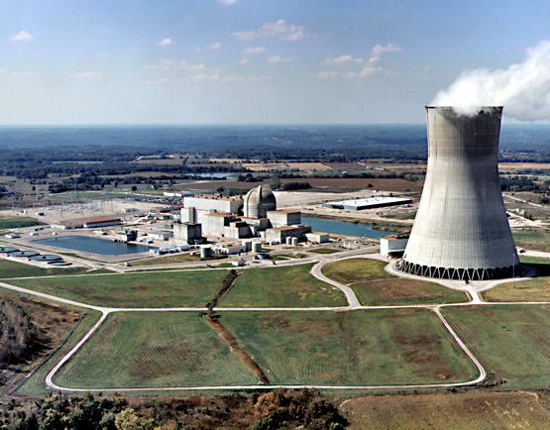
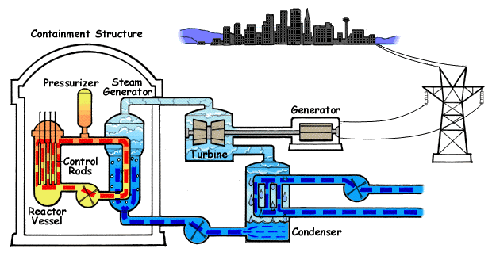
Nuclear
Nuclear Regulatory Commission
Nuclear Regulatory Commission
Notes:
Diagram at left:
NRC Educational (http://www.nrc.gov/reading-rm/basic-ref/students/animated-pwr.html)
Picture at right:
Callaway Nuclear Generating Station, Callaway County, Missouri, 1.19 GW peak generating capacity, pressurized water reactor, operating since 1984
Source: NRC Educational (http://www.nrc.gov/reading-rm/basic-ref/students/reactors.html)
Nuclear power uses energy released from the nuclear fission to heat water, which is then used to turn a turbine to generate electricity in much the same way as in a coal plant. The type of reactor shown in the diagram is a pressurized water reactor. In this design, the water that bathes the radioactive fuel is physically separated from the water than is heated into steam to run the turbine. In another common type of reactor, the boiling water reactor, the steam created from water in the reactor vessel directly turns the turbine.
Most nuclear plants use Uranium as a fuel source. The worldwide Uranium resource base is extremely large. The U.S. has large domestic reserves but does very little uranium mining; most of the uranium that we use is imported. Nuclear fission is stimulated in a controlled chain reaction, and can be halted by inserting the control rods, which absorb the neutrons that cause fission events.
The technology for nuclear power plants was developed in the years after WWII. Commercial nuclear power was very popular and grew rapidly in the 1960s and 1970s, but concerns about safety and the problem of disposal of radioactive waste have halted new construction. Nuclear power currently contributes 20% of electricity generated in the US.
Environmental impacts include the problem of the safe disposal of radioactive materials, the possibility of radiation release during a disaster, and heavy water use.

Slide 13
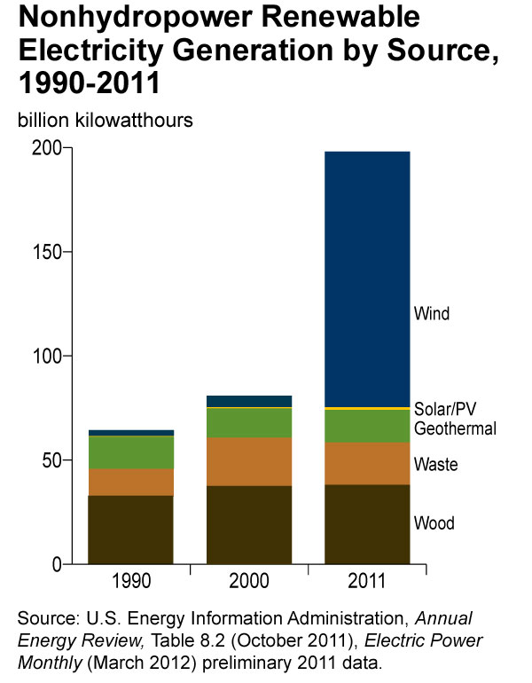
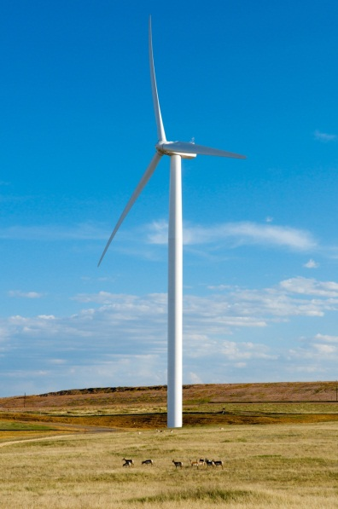
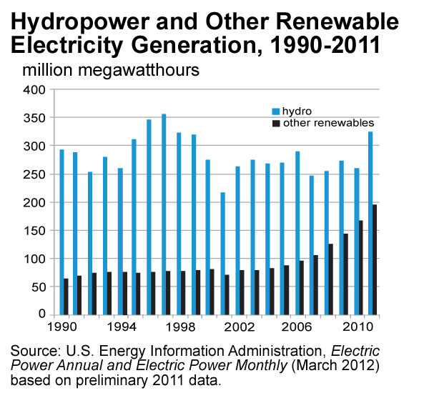
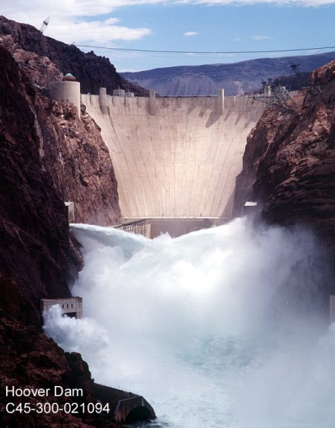
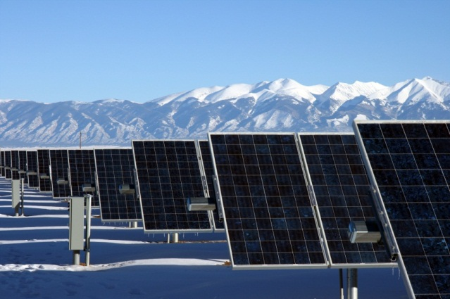
Renewables
Notes:
Plots: http://www.eia.gov/energy_in_brief/article/renewable_electricity.cfm
Dam picture: http://www.usbr.gov/lc/hooverdam/gallery/damviews.html
Wind Turbine: NREL image gallery. Happy Jack Windpower Project in Cheyenne, WY. (http://images.nrel.gov/viewphoto.php?&albumId=207429&imageId=6328129&page=2&imagepos=61)
Solar Panels: NREL image gallery. SunEdison PV Plant near Alamosa, CO. 8.2MW
Renewable sources of electricity are all those where the fuel is a naturally occurring phenomenon that replenishes and will continue to do so into perpetuity. The largest renewable source of electricity is hydropower, but its options for growth are limited. Wind is very fast growing and now comprises almost 3% of all electricity generated. Solar is growing very rapidly but remains a tiny contributor. Wood and waste plants are small contributors, totaling 1.4% of total electricity production together.

Slide 14
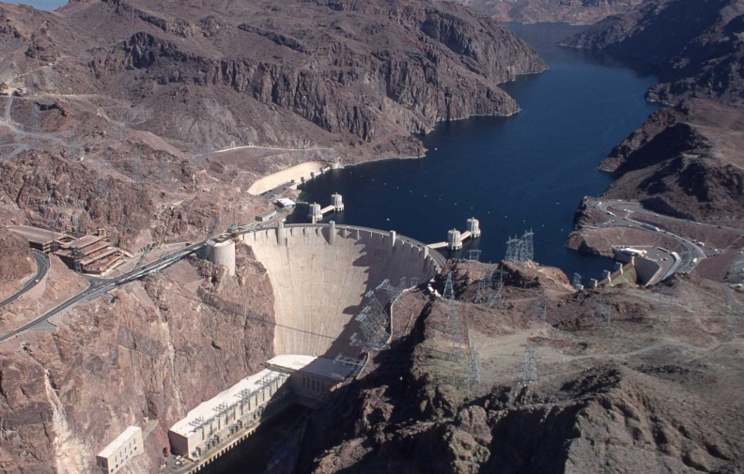
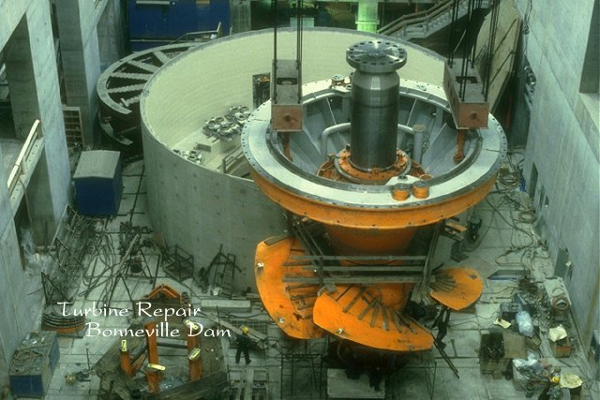
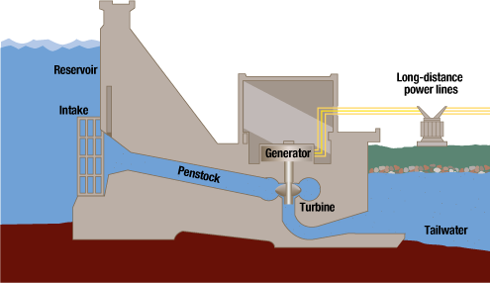
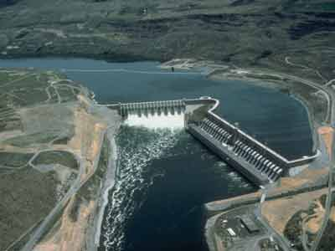
Hydroelectricity
Impoundment hydro: Hoover Dam
Turbines at Bonneville Dam
Run of river hydro: Chief Joseph Dam
Notes:
Schematic source: TVA (http://www.tva.com/power/hydro.htm)
There are a few different kinds of hydropower plants.
One, shown in the schematic and in the image of Hoover dam of AZ / NV, is a containment or impoundment system, where water is accumulated in reservoirs, then released as needed to generate electricity. The gravitational energy stored in the falling water is used to turn a turbine and generate electricity.
An example of run-of-river hydro is shown on the bottom, an image of Chief Joseph Dam in WA. Run-of-river hydro does not involve the impoundment of water, rather the force of the current spins a turbine and generates electricity.
In some systems, referred to as pumped storage, energy can be stored by pumping water uphill when electricity is abundant and then letting it run downhill and turn a turbine when electricity is needed.
Hydropower contributed 8% of total electricity generated in the U.S. in 2011.
Environmental impacts from hydro are generally less severe than from non-renewable sources of electricity, but do include substantial impacts on fish and other wildlife in river ecosystems.

Slide 15
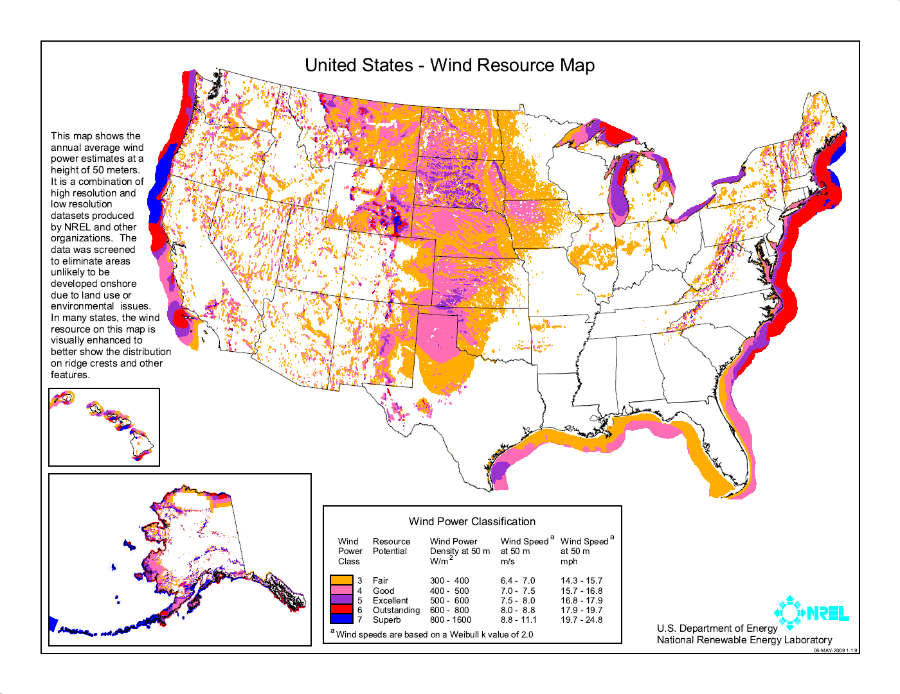
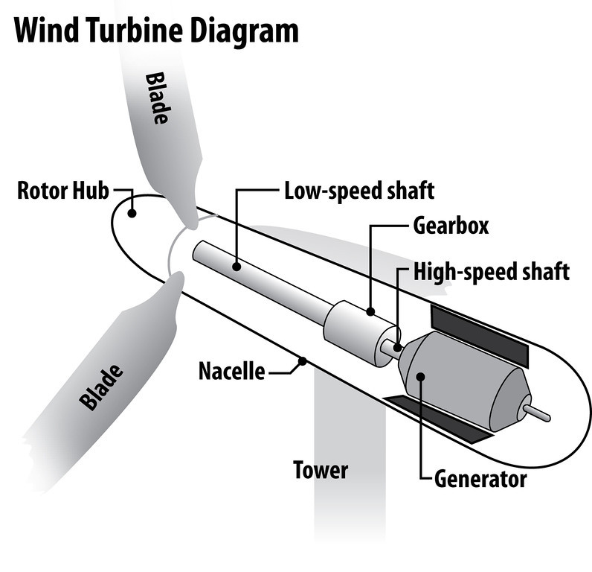
Wind
Notes:
NREL wind map: http://www.nrel.gov/gis/wind.html
Diagram: NEED educational gallery: http://need-media.smugmug.com/Graphics/Graphics/17024036_Bdmf8C/1295822961_pTXRmmn#!i=1289383203&k=5GQKwgR&lb=1&s=A
Wind is one of the more technologically mature sources of renewable energy. The U.S. has abundant wind resources, although it does not tend to be well co-located with population centers. Modern onshore wind turbines are 1-3MW in capacity, and will tend to be clustered into wind farms with a few dozens or hundreds of turbines in modern utility scale wind plants. Kinetic energy in the wind acts to turn the blades, which spin a turbine located in the nacelle. The amount of energy that can be captured by a wind turbine scales as wind speed cubed and as rotor diameter squared. Wind turbines have gotten larger and larger in an attempt to capture more energy for the same footprint, and are now limited by transportability.
The offshore wind resource potential is huge, but the technology is not yet as advanced as it is for onshore wind and costs are significantly higher. Offshore wind turbines can be made larger than onshore turbines because they can be transported by ship to the installation point. Offshore wind turbines are 2-6MW in capacity.
One of the key challenges of incorporating wind energy into the grid is the intermittent nature of the resource. Wind power is not schedulable (dispatchable), and rapidly moving weather fronts can cause very large ramps in the output of wind farms. Wind speed forecasting is an area of very active research.
Environmental impacts include noise pollution, bird deaths from collisions with the blades, and land use changes.

Slide 16
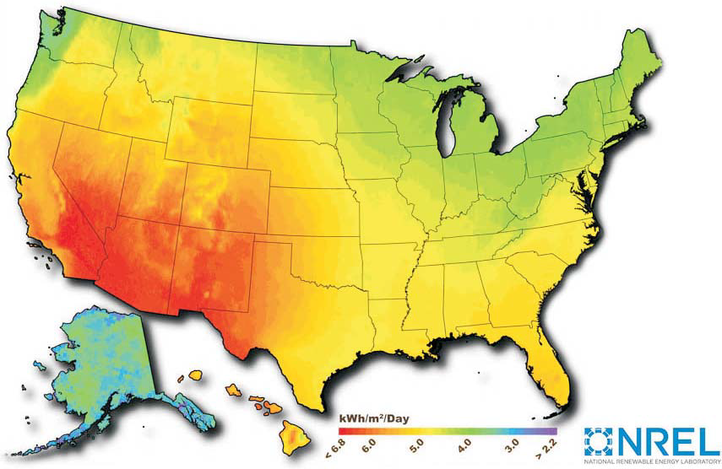
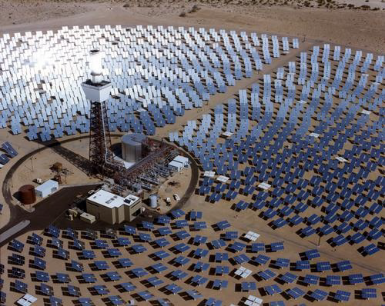

Solar
Concentrating Solar Power, 10MW pilot project. Photo from NREL.
8.2MW SunEdison PV plant in CO. Photo from NREL.
Notes:
Solar PV image lower left: NREL image gallery. SunEdison PV Plant near Alamosa, CO. 8.2MW (http://images.nrel.gov/viewphoto.php?&albumId=207405&imageId=6322391&page=4&imagepos=56)
CSP image at right: NREL report on Utility scale solar. Image of The Solar One facility in California, a 10MW pilot project. http://www.nrel.gov/docs/fy12osti/51137.pdf, page 8
Solar One (later converted to Solar Two) is no longer operational.
Several different technologies have been used to harness the power of the sun to create electricity.
Solar photovoltaic (PV) modules are made of a semiconductor material. Individual photons of sunlight excite an electron and transform directly into electricity. The NREL map at the upper left is a resource map for solar PV. Solar PV currently makes up a tiny fraction of total electricity production, but it is growing extremely rapidly. The cost of solar panels has been rapidly decreasing. Solar panels can be installed as distributed generation, on rooftops or in small installations near end users, or as utility-scale plants.
Solar thermal plants use mirrors to concentrate the heat of the sun onto a working fluid, usually water or molten salts, and then use the heat to run a steam plant that looks very similar to a coal or nuclear plant. The only difference is the source of the heat. The sunlight must be direct, not diffuse, in order to reflect onto the target, and the mirrors track the path of the sun throughout the course of the day. This technology remains very expensive.
Environmental impacts include toxic materials used in the manufacture of some solar cells, land use changes.

Slide 17
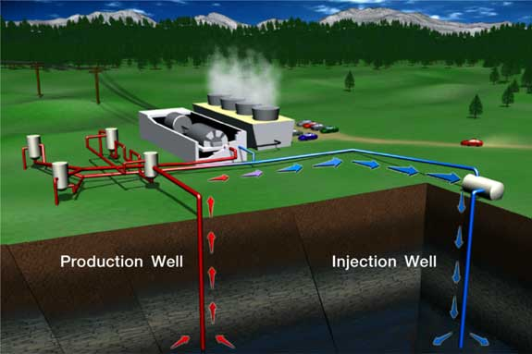
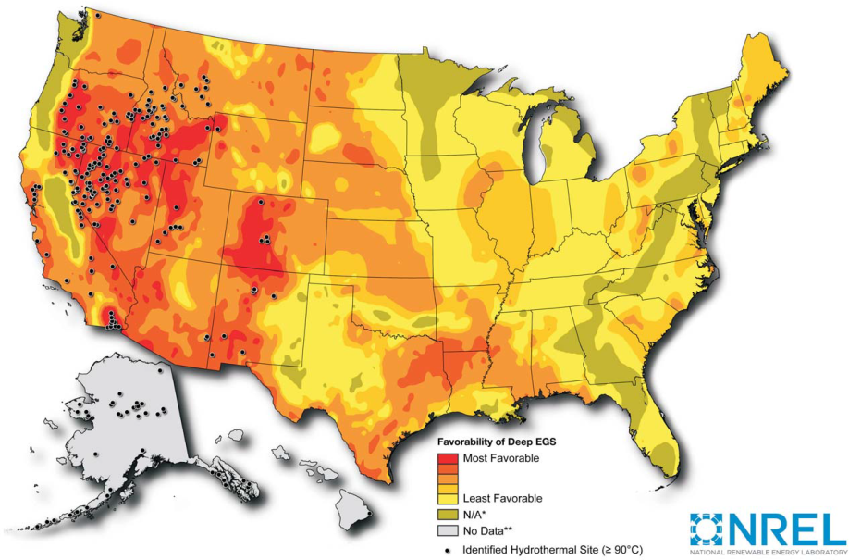
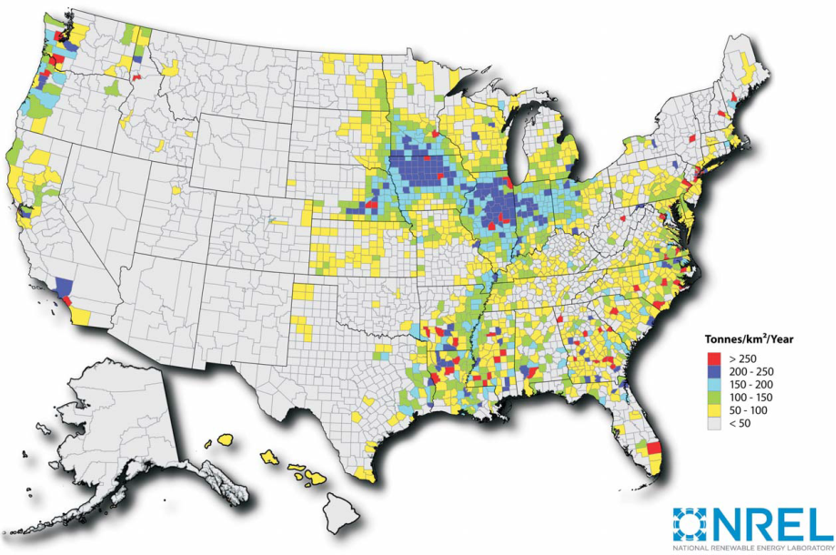
Geothermal and Biomass
Geothermal and biomass power plants are thermal plants, much like coal or nuclear plants.
Geothermal: heat is extracted from the earth’s crust
Biomass: heat is produced by burning wood or waste
Notes:
http://geothermal.marin.org/geopresentation/sld037.htm
Need to add some additional notes here….

Slide 18
Dispatchable Power
Source | (2011) % of generation | capital cost | operationscost | fuel security | environmental impacts | dispatchable
Coal | 42.2% | high | low | very large domestic reserves (>200 yrs) | mining impacts; emission of CO2, mercury, particulates, SO_{x}, NO_{x}; high water use | yes
Natural gas | 24.7% | moderate | moderate | large and rapidly increasing domestic reserves (>100 yrs) | drilling impacts, emission of CO2, high water use | yes
Nuclear | 19.2% | very high | low | large international and domestic reserves | mining of radioactive substances, disposal of radioactive waste, high water use | yes
Hydro | 7.9% | high | very low | risk of drought, add’l large hydro installations unlikely | land use changes, disruption to fish and other aquatic life | somewhat
Wind | 2.9% | high | low | large domestic resource base, but not co-located with population | noise pollution, bird strike, land use changes | no
Solar PV | 0.04% combined solar PV and solar thermal | very high | low | large domestic resource base | some materials used in manufacture are toxic, land use changes | no
Solar thermal |  | very high | low |  | land use changes | somewhat
Geothermal | 0.4% | moderate | high | large domestic resource base | induced seismic activity, water contamination | yes
Biomass | 1.4% | moderate | high |  |  | yes
Notes:
Source: mostly EIA AER, http://www.eia.gov/totalenergy/data/annual/pdf/aer.pdf
Fixed and variable costs from Electricity Market Module report http://www.eia.gov/forecasts/aeo/assumptions/pdf/electricity.pdf
Dispatchable power (coal, natural gas, nuclear, geothermal, and biomass) has a controllable level of output and schedule. Any amount of electricity up to the nameplate capacity can be generated as needed, depending on demand. Somewhat dispatchable power, like hydro and solar thermal, is able to respond to some degree to changes in demand but has limitations. In the case of hydro, the availability of water in reservoirs and environmental regulations limits dispatchability. In the case of solar thermal, thermal inertia allows energy to be stored for a few minutes or hours, but not on greater timescales. Wind and solar PV are not dispatchable, which means that their output is determined by whether the wind is blowing or the sun is shining, which humans cannot control.

Slide 19
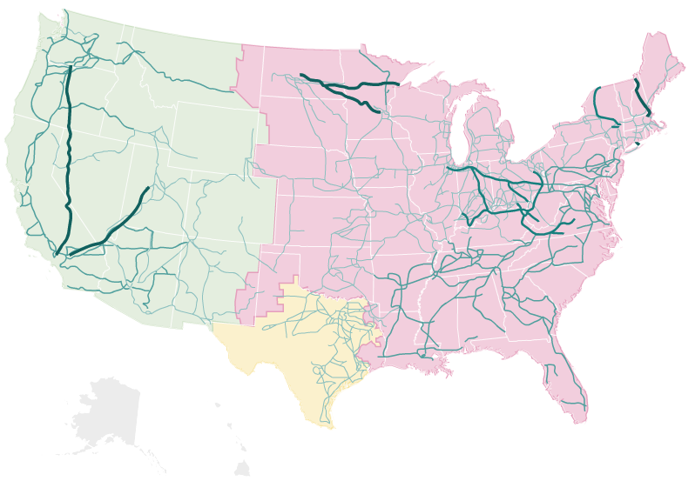
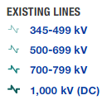
Part 3: Transmission
Notes:
http://www.npr.org/templates/story/story.php?storyId=110997398

Slide 20
Properties of AC and DC
Alternating Current (AC) | Direct Current (DC)
It’s very easy to step AC voltages up or down using a transformer | DC requires expensive power electronics to change voltage level
DC cables can carry more power than AC cables in the same wire cross-section
DC cables have lower losses than AC cables

Slide 21
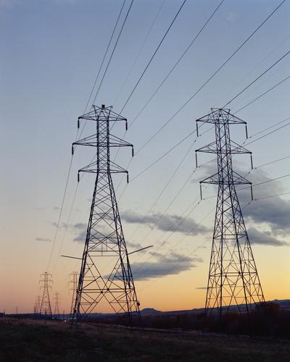
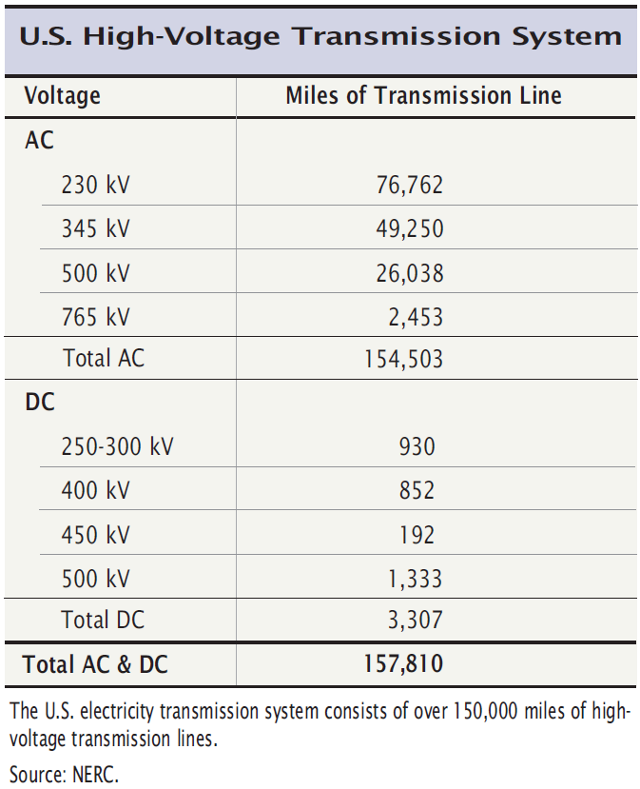
Transmission Lines
Each tower carries two lines of three phases each
conductor
phases A, B, C
insulator
tower
Compare to Total length of U.S. Interstate Highway System: 47,182 miles
Argonne National Lab
Notes:
Table at left: http://www.ferc.gov/industries/electric/gen-info/transmission-grid.pdf
Photo at right: http://plainswindeis.anl.gov/guide/photos/index.cfm

Slide 22
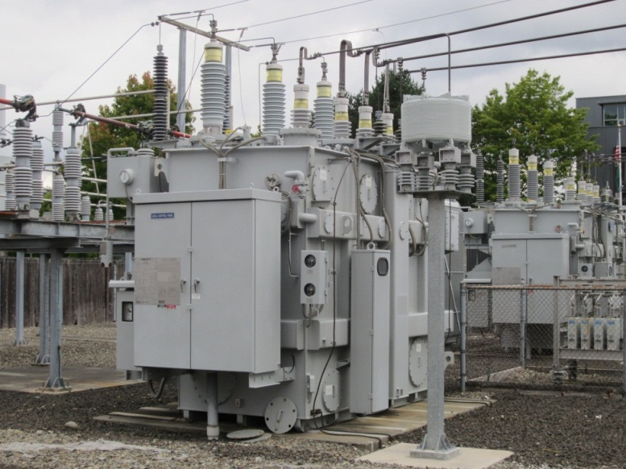
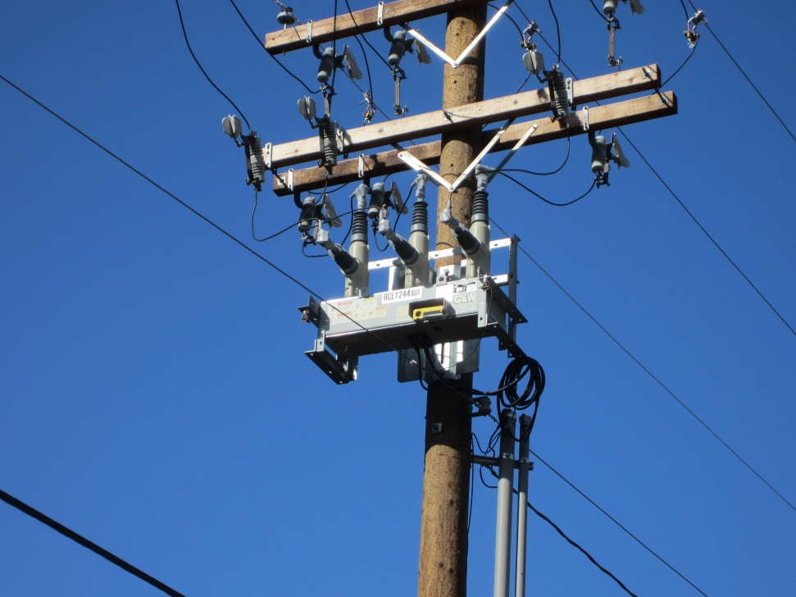
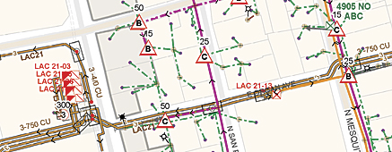
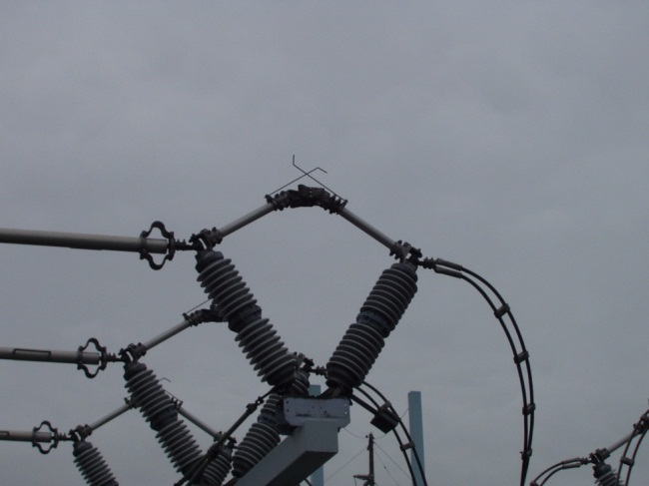
Part 4: Distribution
Notes:
Schematic: El Paso Electric Power Distribution Map, http://www.esri.com/mapmuseum/mapbook_gallery/volume26/utilities-electric-and-gas/utilities-electric-and-gas-4.html
Photographs: taken by Kevin Schneider, PNNL

Slide 23
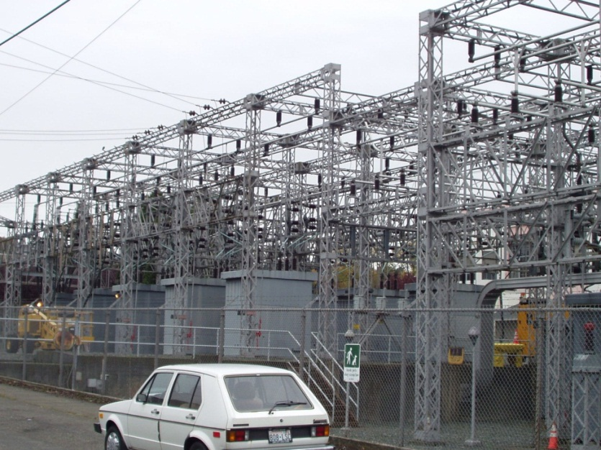

Distribution Substations
Distribution substations connect individual distribution feeders to transmission or sub-transmission system, contain switching equipment to alter the configuration of the feeder supply.
Transformers step voltage down for use at
distribution level.
Notes:
There are many kinds of substations. Substations may contain transformers, voltage control devices such as regulators or capacitor banks, and switches to allow for reconfiguring.
Transformers step voltage from the transmission level (generally higher than 120kV) to the distribution level (usually 12.47kV). Transformers can also transition different voltage levels between the transmission and sub-transmission network. Transformer sizes vary from a few MVA at the distribution level to 1,000MVA at the transmission level. Transformers are very efficient, greater than 98%. The lost energy dissipates as heat, which must be removed either via a circulating water or oil system or by passive or active air cooling.
Voltage regulation devices may be included as part of the transformer block. Some transformers are a fixed ratio, while others (called load tap changers) can switch between a few different ratios.

Slide 24
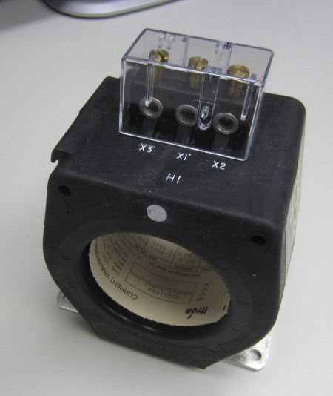
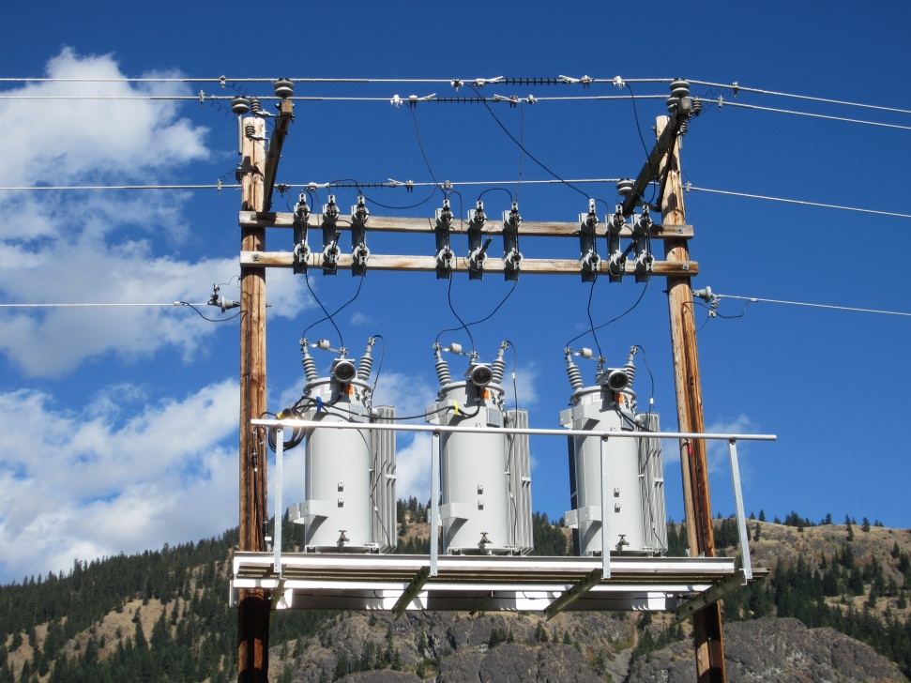
Measurement and Control Devices
Voltage control devices include load tap changers, regulators, and shunt capacitors.
Measurement devices monitor voltage, current, real and reactive power.
Notes:
Measurements devices monitor voltage (static RMS value), current (static RMS value), power (calculated from voltage and current measurements). Phasor measurement units, PMUs, can measure power and phase angle with very high accuracy, allowing dynamics on the system to be studied. There are fewer measurement devices at the distribution level than at the transmission level. Distribution feeders may have some measurement points, may be measured only at the substation, or may have no measurements at all.
Voltage control devices operate at a variety of different levels. At the transmission level, control is largely achieved with adjustment of generator output (sometimes large central capacitor banks, sometimes tap changing transformers). At the distribution level, voltage is controlled by load tap changers (which can toggle between several different transformer ratios), regulators (autotransformers which allow voltage regulation of +/-10%), capacitors (which inject reactive power onto the grid), and in the near future, distributed generation (under new IEEE standards, distributed generation will be able to regulate voltage).

Slide 25
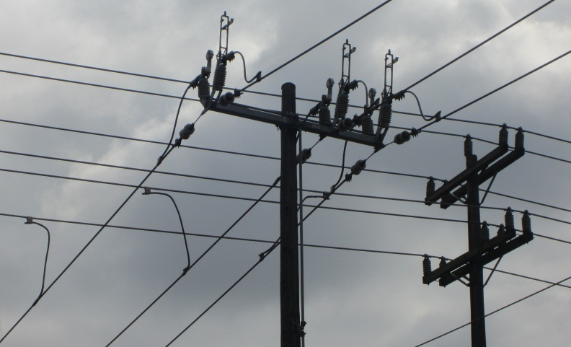

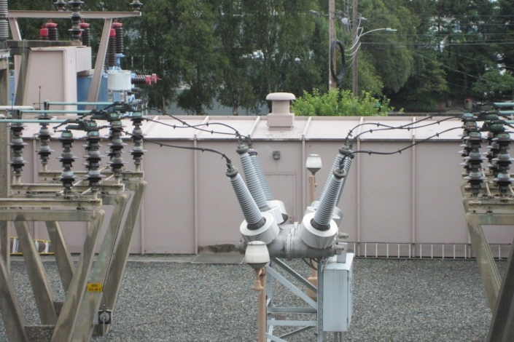
Switches, Breakers, Protective Devices
Switches allow the feeder to be reconfigured.
Protective devices prevent damage to people and equipment in the case of a fault.
Breakers can break a conducting path and interrupt fault current.
Notes:
The primary function of a breaker is to break a conducting line by creating electrical isolation, stopping a fault current. Breakers simply enact the breakage – other equipment is used to determine whether the breaker should open. Breakers are used all levels of the power system. Unlike switches, breakers are meant to be able to interrupt fault current, which can be quite large.
Switches allow feeders to be reconfigured, either for planned maintenance, while fixing infrastructure after an outage, or in order to adapt to changing locations and levels of supply and demand. Many (most?) distribution feeders can be supplied from multiple sources, and switches on the distribution system allow a feeder to be reconfigured. This redundancy increases reliability.
Protective devices are a variety of devices whose purpose is to prevent injury to people and damage to equipment in the case of a fault on the grid. Faults can be caused by vegetation, storms, animals, and human accident or ill intent. The image above is of a recloser, a breaker that can open and then reclose automatically when the fault is cleared.

Slide 26
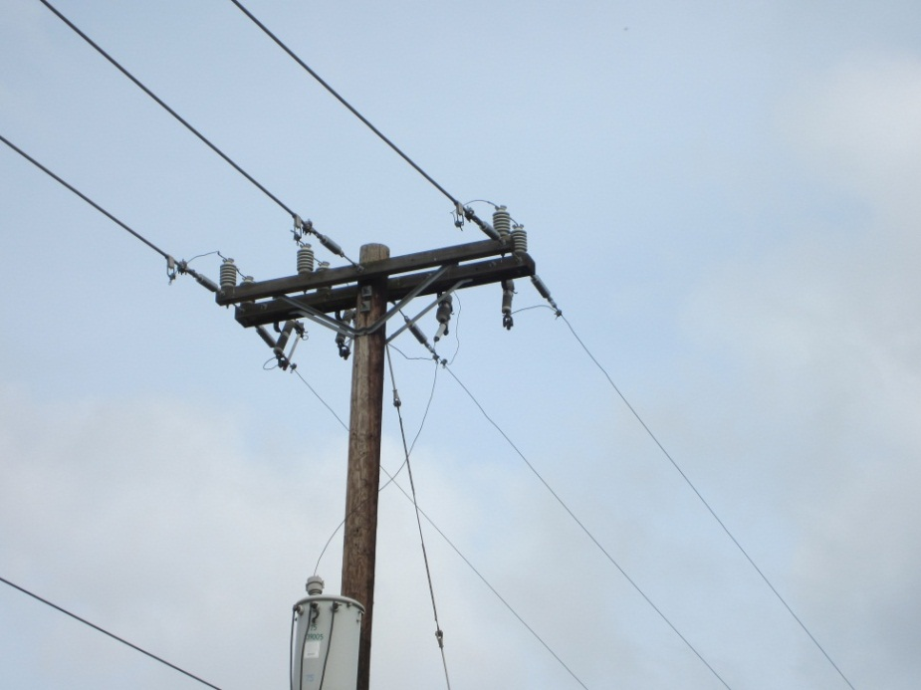
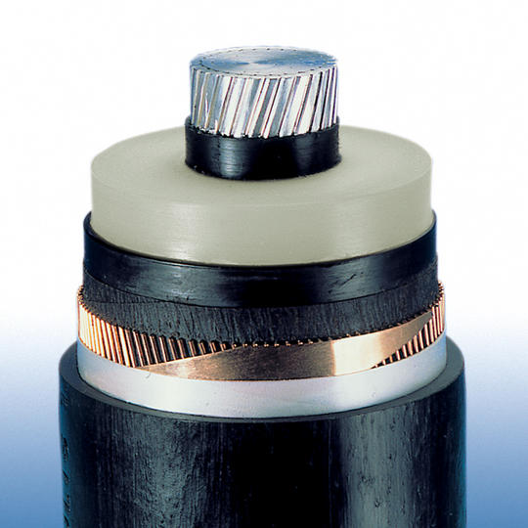
Overhead & Underground Lines
Overhead lines are the most common method of distributing electricity.
Underground cables are used to distribute electricity in dense areas or where overhead lines are undesirable.
Notes:
Overhead lines are the most common way of distributing electricity, given their significantly lower cost as compared to underground cables. They are constructed of aluminum and steel, and are uninsulated. Faults will occur when they come into contact with vegetation, the ground, animals, or people.
Underground cables are used in areas with very high density, numerous momentary faults, or in communities where visible infrastructure is undesirable. Cables can be buried directly or laid in a vault. Underground cables are significantly more expensive than overhead lines (by as much as a factor of ten), so they are not used unless necessary. Faults can be difficult to isolate and repair.

Slide 27
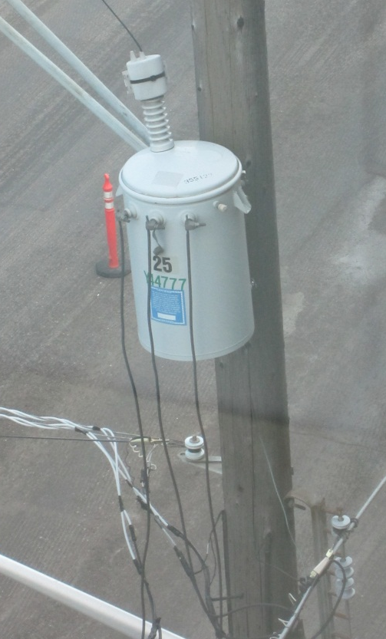
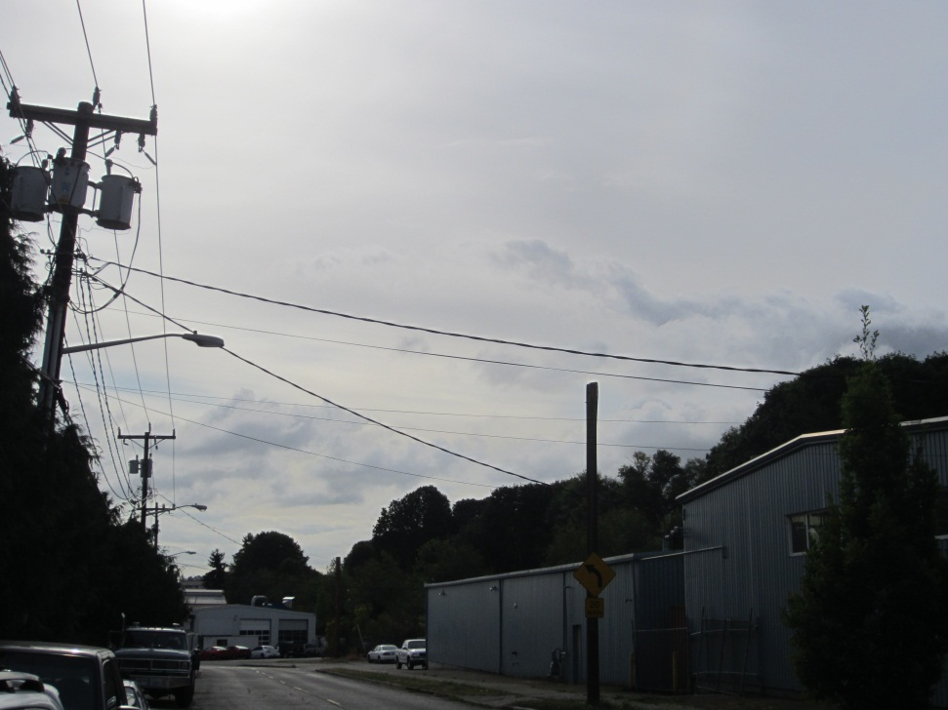
Service Transformers & Triplex Cables
Triplex cables carry power from service transformers to end user.
Service transformers lower the voltage from distribution levels to levels used by end users.
Notes:
Service transformers step down voltage from distribution levels to levels used by end users. They can be pole mounted or pad mounted, and can be single phase or three phase. Single phase residential transformers are center tapped so that 120V and 240V are available. A single service transformer can serve multiple customers.
Triplex cable is used to connect the service transformer to the end user. There are three lines – two are live and insulated, and one is the neutral or grounding wire, usually bare. 120V can be obtained between a live wire and ground, and 240V can be obtained between the two live wires, which have opposite polarity.

Slide 28
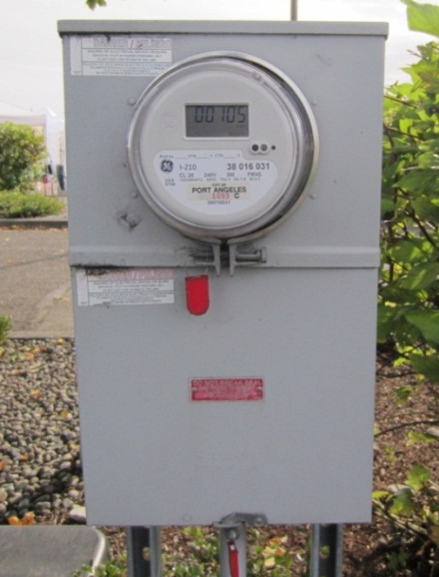
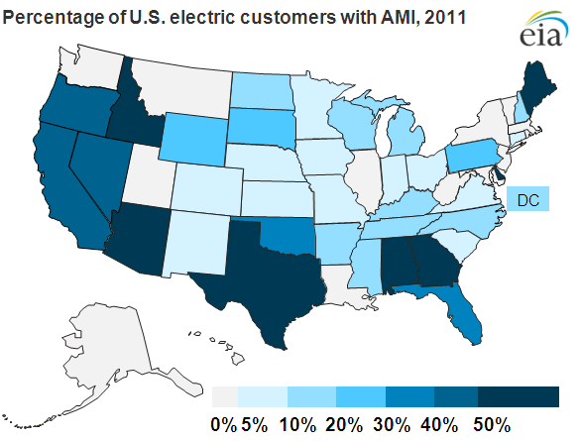
Metering
Meters are installed at all end-use customers to track power use for system monitoring and billing. Advanced Metering Infrastructure (AMI) is becoming more common. AMI includes two-way communication and power demand tracked over 1-15 minutes instead of 1 month.

Slide 29

Part 5: Operations
ERCOT control room
Notes:
ERCOT control room: http://www.isorto.org/site/c.jhKQIZPBImE/b.2604605/k.C12F/ERCOT.htm
Arrange this hierarchically
Reliability
Transmission / ISO
Distribution ultiity

Slide 30
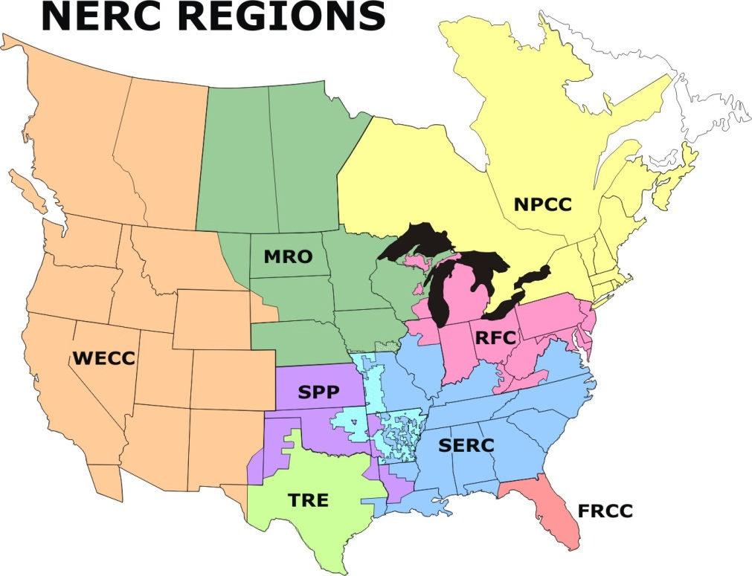
High Level Organizing Entities
North American Electric Reliability Corporation (NERC)
  established to ensure that the grid is reliable, adequate, and secure
  non-governmental organization, granted the legal authority to enforce reliability standards
Federal Energy Regulatory Committee (FERC)
  regulates interstate transmission of natural gas, oil, and electricity, as well as natural gas and hydropower projects
  independent federal entity
Notes:
(http://www.nerc.com/page.php?cid=1|9|119)

Slide 31
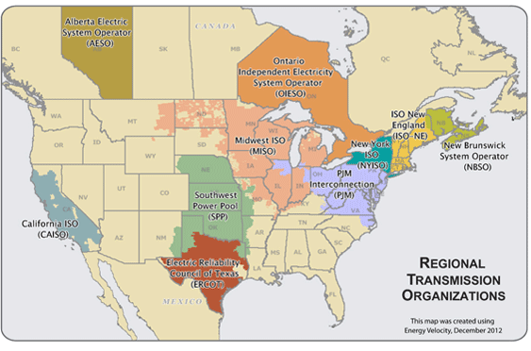
Regional Regulatory Bodies
Independent System Operators (ISO) and Regional Transmission Operators (RTO)
  monitor and control the flow of power on the transmission grid
  administer region’s wholesale electricity markets
  reliability planning
Notes:
Map from FERC: http://www.ferc.gov/industries/electric/indus-act/rto.asp

Slide 32
Generation Scheduling
Economic dispatch
  Order all generating units from lowest marginal price to highest marginal price.
  Dispatch units from least to most expensive until load is satisfied.
Unit commitment
  Given a load forecast and unit constraints including:
    Start-up and shut-down times and costs
    Min and max stable operating level
    Min and max ramping rate
  Determine optimal subset of units to turn on
  Determine optimal schedule for turning units on and off
Optimal Power Flow
  Adjust unit commitment schedule to comply with additional factors
    Transmission capacity and power flow constraints
    Environmental impacts
    Security constraints and contingency
Notes:
Economic dispatch refers to the process whereby it is decided which generation plants should be activated and at what level. All of the generating plants in a region declare their marginal price, or the variable cost of producing an additional MWh of electricity. The bids are all put in a stack in order of least expensive to most expensive, and then the bids are accepted in order until the demand is met. In most systems, after this step, practical considerations of transmission congestion, environmental impacts, and other factors are taken into account, and the dispatch order will be adjusted.

Slide 33
Cyclical variations in demand
in ISO-NE, 2002

Slide 34
peak load
intermediate load
base load
x axis: number of hours per year the corresponding load (GW) is exceeded

Slide 35
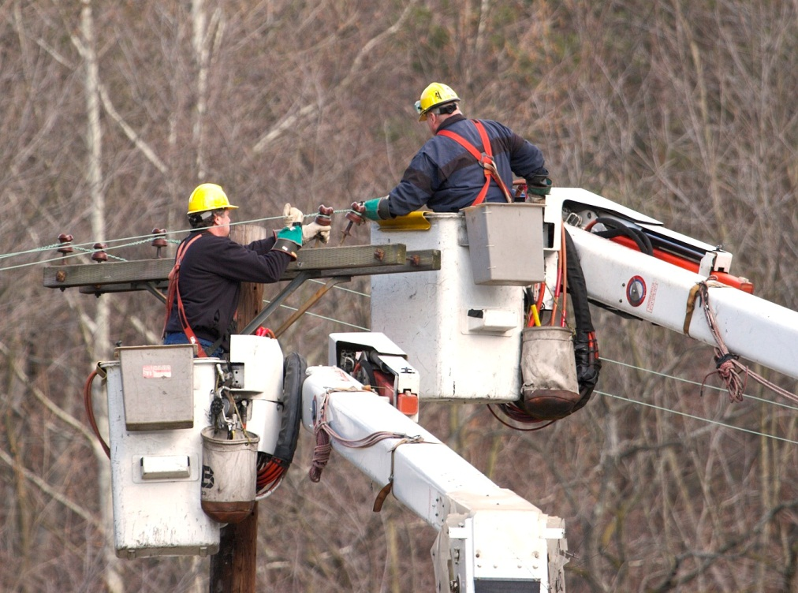
Distribution Utilities
Distribution utilities are responsible for all physical infrastructure between transmission substations and end users
  Substations and protective equipment
  Overhead and underground lines
  Service transformers
  Metering
Distribution is a regulated monopoly
  Remuneration for operating expenses is set by a Public Utility Commission
Distribution utilities can be municipal, public, or private

Slide 36
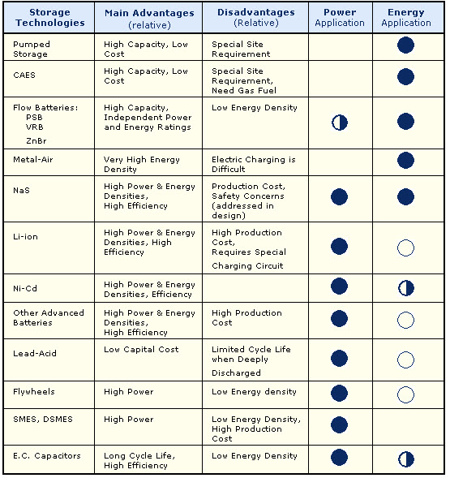
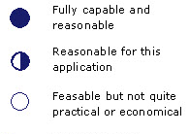
Energy Storage
In all but a few cases, grid scale energy storage is still too expensive to be feasible.
That may change in future with improving technology and with growing challenge of incorporating intermittent renewable sources of energy into the grid.
Notes:
http://www.pnl.gov/main/publications/external/technical_reports/PNNL-19703.pdf, Table A-1
Analysis Tools for Sizing and Placement of Energy Storage in Grid Applications
A Literature Review
MG Hoffman A Sadovsky MC Kintner-Meyer JG DeSteese
September 2010

Slide 37
A Sampling of Emerging Technologies
Demand response
Distributed generation
Intermittent renewables
Electric vehicles

