Slide 1
Smart Buildings
Microgrid Innovations
Energy and Construction Best Practices Summit | June 23, 2011

Slide 2
Net Zero Building
Efficient – Waste, Water, Energy
Smart – Operations, Occupants
Clean – Distributed Renewable Energy
When approached in this order, a NET ZERO BUILDING is possible.
Efficient
Clean
Net Zero
Smart

Slide 3

Smart Building Definition
A “Smart Building” integrates major building systems on a common network and shares information and functionality between systems to improve energy efficiency, operational effectiveness, and occupant satisfaction.*
  * Lawrence Berkley Lab study released in August 2009
Notes:
Make visual and less wordy

Slide 4
Smart Building Cost Study
Smart Building improvements can:
  Reduce annual energy costs
  Reduce annual operating costs
Investment required:
  Core building systems of $0.35/ sq. ft.
  Systems integration of $0.22/sq. ft.
  Enterprise operations of $0.29/sq. ft.
  Total investment of $0.88/sp. ft.
  * Lawrence Berkley Lab study released in August 2009
4%
$1.93/sq. ft.
$1.85/sq. ft.
12%
$3.70/sq. ft.
$3.26/sq. ft.
< 2 Yr. Payback
Notes:
Make visual and less wordy

Slide 5
Smart Building Implementation
On Site
Networked Building Control Systems accessible via the internet through a single open source gateway.
Building performance “dashboards” with actionable information so building occupants and operators can further optimize building performance.
Off Site
Real time monitoring, verification, analysis and optimization of building performance.

Slide 6




Smart Building I.T. Architecture
Web-based
Enterprise
Platform
Remote/ offsite desktop or laptop. Access is via the Internet
or
Normalizing the Data
Integration Platform
Internet
Workstation Connected to Ethernet
Smart Equipment
Disparate Systems

Slide 7



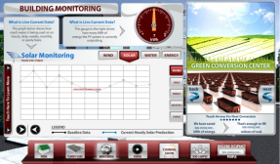






Smart Building Information Platform
Utility/Smart Grid
Client Portals
Web
Information Platform
Analysis
Facility Information
Energy Information
Vendor Management
A/P Integration
Issue / Work Order Management
Monitor Based Commissioning
Energy Management
LEED Documentation
Utility Bill Analysis
Environmental Management
Facility Condition Assessment
Building Performance Optimization
Building System Live Data
Asset Management

Slide 8






Smart Building: Information Enables Action
Identification
Measurement & Verification
Reporting
Resolution
Procedure Implemented
Dispatch /
Notification

Slide 9
Achieving Smart Building Outcomes
Engineered Smart
Delivered Smart
Operated Smart

Slide 10


New Construction + Smart Building
Trends & Predictions

Slide 11

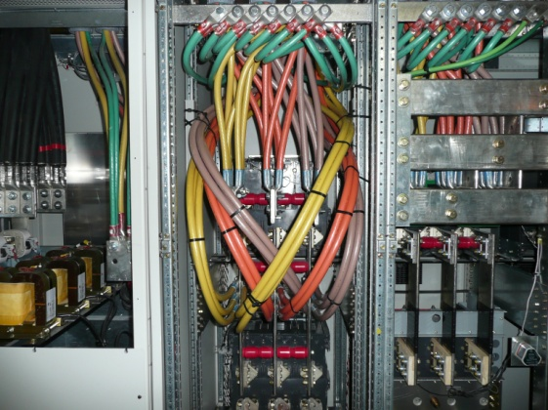
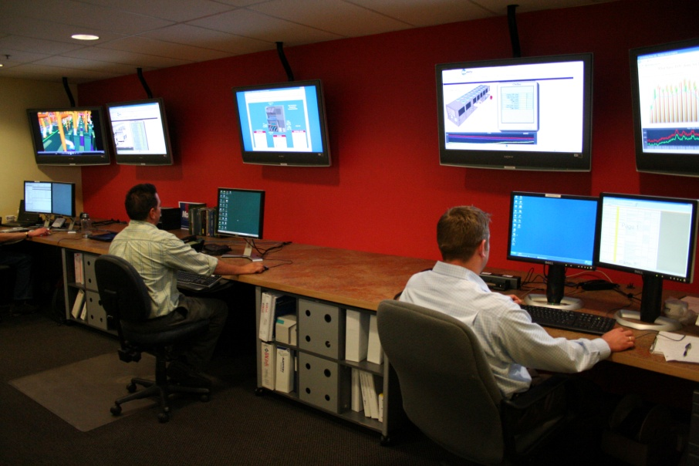
New Construction + Smart Building
What’s different? Where are the big impacts?
Engineered Smart
Significant cross discipline realignment.
New design specialty emerging.
Delivered Smart
Minimal additional work during construction.
Systems, devices connect to Building I.T. network rather than private vendor network
Operated Smart
Significant change coming.
7x24 Building Operations Centers will monitor and intervene to improve Building Performance.

Slide 12
Smart Building Job Opportunities
Engineered Smart
Mechanical engineers, energy engineers, electrical engineers, I.T. network engineers.
Delivered Smart
Data cable installers, I.T. field engineers, electricians, plumbers, pipe fitters, project managers.
Operated Smart
Customer service representatives, energy engineers, commissioning engineers, facility engineers, I.T. professionals.

Slide 13
Thank You!
DougM@McKinstry.com

